Slide 1

P2P Networks
Mayank Pandey
Motilal Nehru National Institute of Technology,
Allahabad, Uttar Pradesh, India

Slide 2
How Did it Start?
A killer application: Napster
– Free music over the Internet
Key idea: share the content, storage and bandwidth of individual (home) users
Each user stores a subset of files
Each user has access (can download) files from all users in the system

Slide 3
Challenges:
Find where a particular file is stored
Scalability: up to hundred of thousands or millions of systems
Dynamicity: systems can come and go any time

Slide 4
Napster
Napster history: the rise
January 1999: Napster version 1.0
May 1999: company founded
December 1999: first lawsuits
2000: 80 million users
Napster history: the fall
Mid 2001: out of business due to lawsuits

Slide 5
Napster Technology
User installing the software
Download the client program
Register name, password, local directory, etc.
Client contacts Napster (via TCP)
Provides a list of music files it will share
… and Napster’s central server updates the directory
Client searches on a title or performer
Napster identifies online clients with the file
… and provides IP addresses
Client requests the file from the chosen supplier
Supplier transmits the file to the client
Both client and supplier report status to Napster
Bob
centralized
directory server
1
peers
1
1
3
2
1
Alice

Slide 6
Napster: Properties
Server’s directory continually updated
Always know what music is currently available
Point of vulnerability for legal action
Peer-to-peer file transfer
No load on the server
Plausible deniability for legal action (but not enough)

Slide 7
Napster: Properties
Proprietary protocol
- Login, search, upload, download, and status operations
- No security: clear text passwords and other vulnerability
Bandwidth issues
- Suppliers ranked by apparent bandwidth & response time

Slide 8
Napster: Limitations
Single point of failure
Performance bottleneck
Copyright infringement
So, later P2P systems were more distributed
- Gnutella went to the other extreme

Slide 9
Pure P2P system: Gnutella
Gnutella history
2000: J. Frankel & T. Pepper released Gnutella
Soon after: many other clients (e.g., Morpheus, Limewire, Bearshare)
2001: protocol enhancements, e.g., “ultrapeers”
Query flooding
Join: contact a few nodes to become neighbors
Publish: no need!
Search: ask neighbors, who ask their neighbors
Fetch: get file directly from another node

Slide 10
Gnutella: Query Flooding
Fully distributed
No central server
Public domain protocol
Many Gnutella clients implementing protocol
Overlay network: graph
Edge between peer X and Y if there’s a TCP connection
All active peers and edges is overlay net
Given peer will typically be connected with < 10 overlay neighbors

Slide 11
Gnutella: Protocol
File transfer:
HTTP
Query message sent over existing TCP connections
Peers forward Query message
QueryHit sent over reverse path
Query
QueryHit
Query
QueryHit
Query
Query
QueryHit
Scalability:
limited scope flooding
Query

Slide 12
Gnutella: Peer Joining
Joining peer X must find some other peers
Start with a list of candidate peers
X sequentially attempts TCP connections with peers on list until connection setup with Y
X sends Ping message to Y
Y forwards Ping message.
All peers receiving Ping message respond with Pong message
X receives many Pong messages
X can then set up additional TCP connections

Slide 13
Gnutella: Pros and Cons
Advantages
Fully decentralized
Search cost distributed
Processing per node permits powerful search semantics
Disadvantages
Search scope may be quite large
Search time may be quite long
High overhead, and nodes come and go often

Slide 14
Hybrid P2P system: KaAzA
KaZaA history
2001: created by Dutch company (Kazaa BV)
Smart query flooding
Join: on start, the client contacts a super-node (and may later become one)
Publish: client sends list of files to its super-node
Search: send query to super-node, and the super-nodes flood queries among themselves
Fetch: get file directly from peer (s); can fetch from multiple peers at once

Slide 15
KaZaA: Exploiting Heterogeneity
Each peer is either a group leader or assigned to a group leader
TCP connection between peer and its group leader
TCP connections between some pairs of group leaders
Group leader tracks the content in all its children

Slide 16
KaZaA: Motivation for Super-Nodes
Query consolidation
Many connected nodes may have only a few files
Propagating query to a sub-node may take more time than for the super-node to answer itself
Stability
Super-node selection favors nodes with high up-time
How long you’ve been on is a good predictor of how long you’ll be around in the future

Slide 17

P2P Case study: Skype
Skype clients (SC)
inherently P2P: pairs of users communicate.
proprietary application-layer protocol
hierarchical overlay with SNs
Index maps usernames to IP addresses; distributed over SNs
Skype
login server
Supernode (SN)

Slide 18
Peers as relays
Problem when both Alice and Bob are behind “NATs”.
NAT prevents an outside peer from initiating a call to insider peer
Solution:
Using Alice’s and Bob’s SNs, Relay is chosen
Each peer initiates session with relay.
Peers can now communicate through NATs via relay

Slide 19
BitTorrent
BitTorrent history and motivation
2002: B. Cohen debuted BitTorrent
Key motivation: popular content
Popularity exhibits temporal locality (Flash Crowds)
Focused on efficient fetching, not searching
Distribute same file to many peers
Few publisher, many downloaders

Slide 20
BitTorrent: Simultaneous Downloading
Divide large file into many pieces
Replicate different pieces on different peers
A peer with a complete piece can trade with other peers
Peer can (hopefully) assemble the entire file
Allows simultaneous downloading
Retrieving different parts of the file from different peers at the same time
And uploading parts of the file to peers
Important for very large files

Slide 21
BitTorrent Components
CSC 458/CSC 2209 – Computer Networks
University of Toronto – Fall 2008
21
Seed
Peer with entire file
Fragmented in pieces
Leacher
Peer with an incomplete copy of the file
Torrent file
Passive component
Stores summaries of the pieces to allow peers to verify their integrity
Tracker
Allows peers to find each other
Returns a list of random peers
Notes:
21

Slide 22
BitTorrent: Tracker
Infrastructure node
Keeps track of peers participating in the torrent
Peers register with the tracker
Peer registers when it arrives
Peer periodically informs tracker it is still there

Slide 23
BitTorrent: Tracker
Tracker selects peers for downloading
Returns a random set of peers
Including their IP addresses
So the new peer knows who to contact for data

Slide 24
BitTorrent: Chunks
Large file divided into smaller pieces
Fixed-sized chunks
Typical chunk size of 256 Kbytes
Allows simultaneous transfers
Downloading chunks from different neighbors
Uploading chunks to other neighbors
Learning what chunks your neighbors have
Periodically asking them for a list
File done when all chunks are downloaded

Slide 25
BitTorrent: Overall Architecture
Web Server
Tracker
Web page
with link
to .torrent
.torrent
C
A
Peer
[Seed]
Peer
[Leech]
Downloader
“US”
B
Peer
[Leech]

Slide 26
BitTorrent: Overall Architecture
Web Server
Tracker
Web page
with link
to .torrent
Get-announce
C
A
Peer
[Seed]
Peer
[Leech]
Downloader
“US”
B
Peer
[Leech]

Slide 27
BitTorrent: Overall Architecture
Web Server
Tracker
Web page
with link
to .torrent
Response-peer list
C
A
Peer
[Seed]
Peer
[Leech]
Downloader
“US”
B
Peer
[Leech]

Slide 28
BitTorrent: Overall Architecture
Web Server
Tracker
Web page
with link
to .torrent
Shake-hand
C
A
Peer
[Seed]
Peer
[Leech]
Downloader
“US”
Shake-hand
B
Peer
[Leech]

Slide 29
BitTorrent: Overall Architecture
Web Server
Tracker
Web page
with link
to .torrent
pieces
C
A
pieces
Peer
[Seed]
Peer
[Leech]
Downloader
“US”
B
Peer
[Leech]

Slide 30
BitTorrent: Overall Architecture
Web Server
Tracker
Web page
with link
to .torrent
pieces
C
A
pieces
Peer
[Seed]
Peer
[Leech]
Downloader
“US”
pieces
B
Peer
[Leech]

Slide 31
BitTorrent: Overall Architecture
Web Server
Tracker
Web page
with link
to .torrent
Get-announce
Response-peer list
pieces
C
A
pieces
Peer
[Seed]
Peer
[Leech]
Downloader
“US”
pieces
B
Peer
[Leech]

Slide 32
BitTorrent: Chunk Request Order
Which chunks to request?
Could download in order
Like an HTTP client does
Problem: many peers have the early chunks
Peers have little to share with each other
Limiting the scalability of the system
Problem: eventually nobody has rare chunks
E.g., the chunks need the end of the file
Limiting the ability to complete a download
Solutions: random selection and rarest first

Slide 33
BitTorrent: Rarest Chunk First
Which chunks to request first?
The chunk with the fewest available copies
Benefits to the peer
Avoid starvation when some peers depart
Benefits to the system
Avoid starvation across all peers wanting a file
Balance load by equalizing # of copies of chunks

Slide 34
Free-Riding Problem in P2P Networks
Vast majority of users are free-riders
Most share no files and answer no queries
Others limit # of connections or upload speed
A few “peers” essentially act as servers
A few individuals contributing to the public good
Making them hubs that basically act as a server
BitTorrent prevent free riding
Allow the fastest peers to download from you
Occasionally let some free loaders download

Slide 35
Bit-Torrent: Preventing Free-Riding
Peer has limited upload bandwidth
And must share it among multiple peers
Prioritizing the upload bandwidth: tit for tat
Favor neighbors that are uploading at highest rate
Rewarding the top four neighbors
Measure download bit rates from each neighbor
Reciprocates by sending to the top four peers
Re-compute and reallocate every 10 seconds
Optimistic un-choking
Randomly try a new neighbor every 30 seconds
So new neighbor has a chance to be a better partner

Slide 36
BitTorrent Today
Significant fraction of Internet traffic
Estimated at 30%
Though this is hard to measure
Problem of incomplete downloads
Peers leave the system when done
Many file downloads never complete
Especially a problem for less popular content
Still lots of legal questions remains
Further need for incentives

Slide 37
P2P : Types
Two main P2P Network types
Unstructured (based on searching)
“Network has structure, but peers are free to join any where and objects can be stored anywhere”
Structured (based on addressing)
“Network structure determines where peers belong in the network and where objects are stored “

Slide 38
Another Classification
1st generation
Typically: Napster
2nd generation
Typically: Gnutella
3rd generation
Typically: Super-peer networks
4th generation
Typically: Distributed hash tables
Note: For DHTs, no division into generations yet

Slide 39
Distributed Hash Tables (DHT)
What are they?
How they work?
What are they good for?
Specific Example: The Chord

Slide 40
DHT: Motivation
Why we need DHTs?
Searching in P2P networks is not efficient
Either centralized system with all its problems
Or distributed system with all its problems
Hybrid systems cannot guarantee discovery either
Actual file transfer process in P2P network is scalable
File transfers directly between peers
Searching does not scale in same way
Original motivation for DHTs: More efficient searching and object location in P2P networks
Put another way: Use addressing instead of searching

Slide 41
Recall: Hash Tables
Hash tables are a well-known data structure
Hash tables allow insertions, deletions, and finds in constant (average) time
Hash table is a fixed-size array
--Elements of array also called hash buckets
Hash function maps keys to elements in the array
Properties of good hash functions:
--Fast to compute
--Good distribution of keys into hash table
--Example: SHA-1 algorithm

Slide 42
Hash Tables: Example
Hash function: hash(x) = x mod 10
Insert numbers 0, 1, 4, 9,16, and 25
Easy to find if a given key is
present in the table

Slide 43
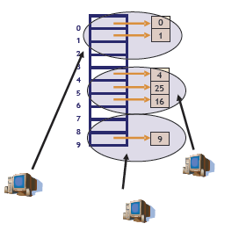
Distributed Hash Table: Idea
Hash tables are for fast lookups
Idea: Distribute hash buckets to peers
Result is Distributed Hash Table (DHT)
Need efficient mechanism for finding
which peer is responsible for which
bucket and routing between them

Slide 44
DHT: Principle
In a DHT, each node is responsible for
one or more hash buckets
As nodes join and leave, the
responsibilities change
Nodes communicate to find the
responsible node
Scalable communications make DHTs
efficient
DHTs support all the normal hash table
operations

Slide 45
Summary of DHT Principles
Hash buckets distributed over nodes
Nodes form an overlay network
--Route messages in overlay to find responsible node
Routing scheme in the overlay network is the difference
between different DHTs
DHT behavior and usage:
Node knows “object” name and wants to find it
--Unique and known object names assumed
Node routes a message in overlay to the responsible node
Responsible node replies with “object”
--Semantics of “object” are application defined

Slide 46
DHT Examples
Chord
CAN
Tapestry
Several others exist too
Pastry, Plaxton, Kademlia, Koorde, Symphony, P-Grid, CARP, …

Slide 47
Chord
Chord was developed at MIT
Originally published in 2001 at Sigcomm conference
--Paper has mathematical proofs of correctness and performance
Many projects at MIT around Chord
CFS storage system
Ivy storage system
Plus many others…

Slide 48
Chord: Basics
Chord uses SHA-1 hash function
Results in a 160-bit object/node identifier
Same hash function for objects and nodes
Node ID hashed from IP address
Object ID hashed from object name
Object names somehow assumed to be known by everyone
SHA-1 gives a 160-bit identifier space
Organized in a ring which wraps around
Nodes keep track of predecessor and successor
Node responsible for objects between its predecessor and itself
Overlay is often called “Chord ring” or “Chord circle”

Slide 49
Chord: Various Procedures
Joining the network
Storing in to the network
Retrieving from the network

Slide 50
Joining: Step-By-Step Example
Setup: Existing network with nodes
on 0, 1 and 4
Many different ways to implement
Chord
--Here only conceptual example
--Covers all important aspects

Slide 51
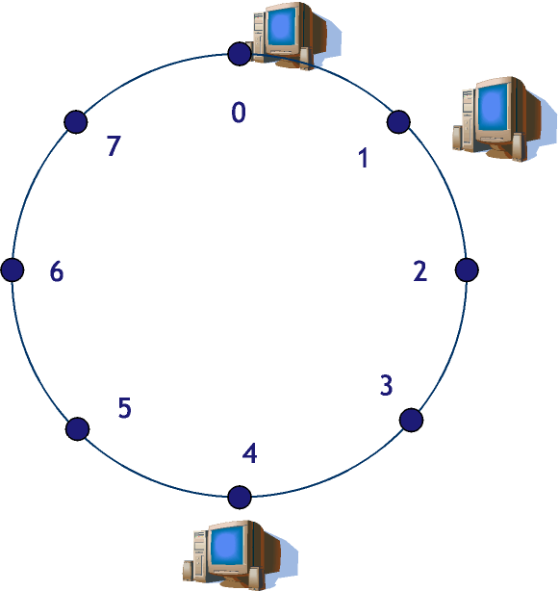

Joining: Step-By-Step Example
New node wants to join
Hash of the new node: 6
Known node in network: Node1
Contact Node 1
--Include own hash

Slide 52
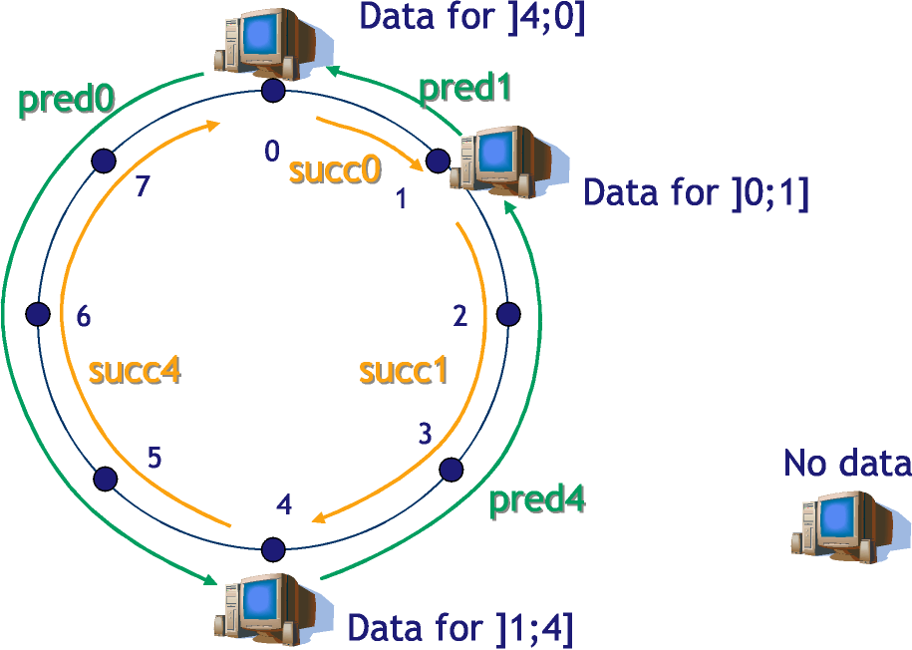
Joining: Situation Before Join

Slide 53
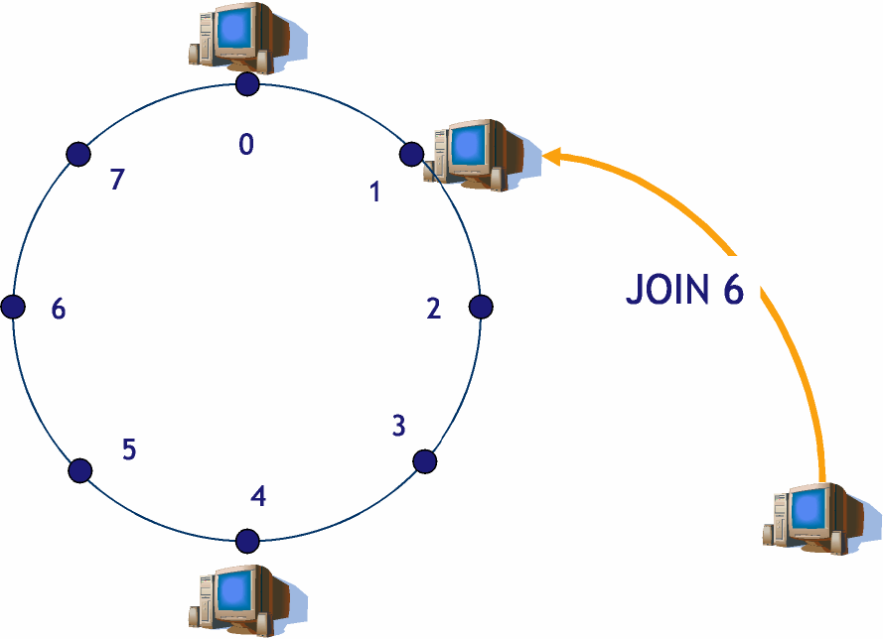
Joining: Contact known node

Slide 54
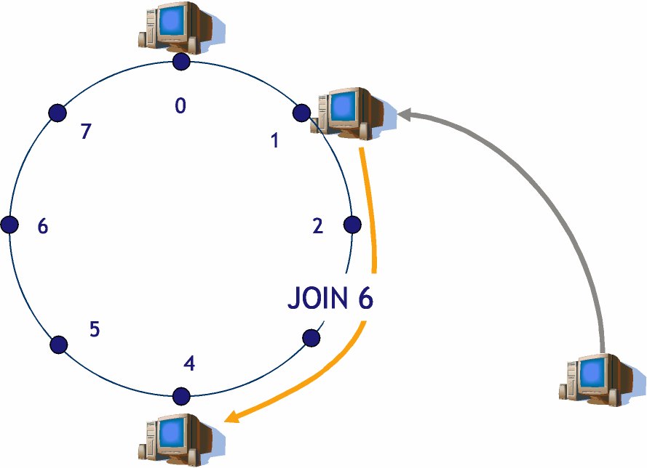
Joining: Join gets routed along the network

Slide 55
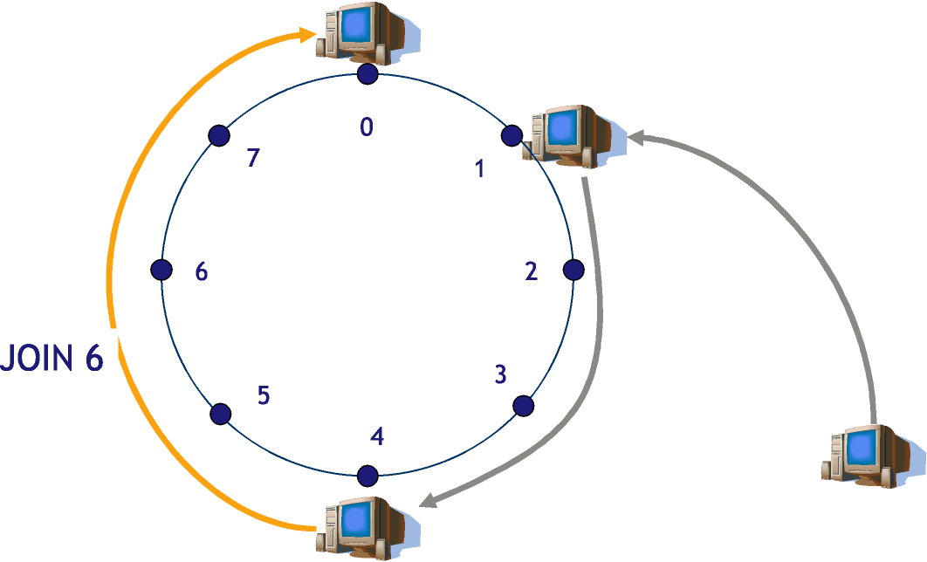
Joining: Successor of New Node Found

Slide 56
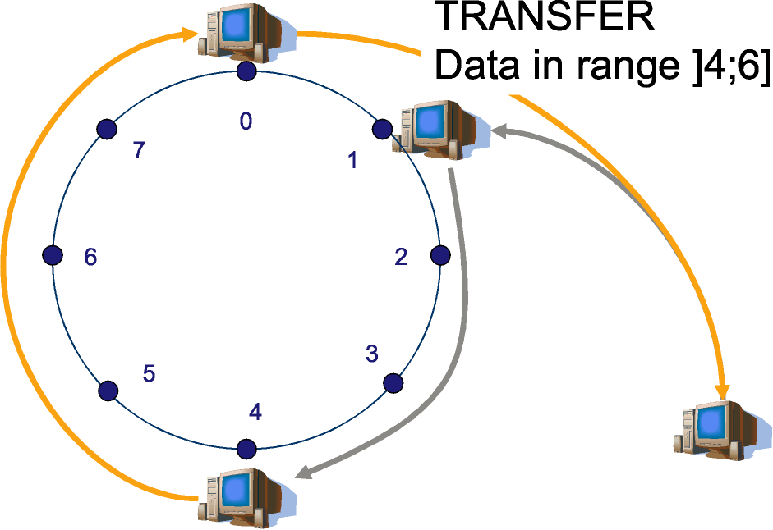
Joining: Joining Successful + Transfer
Joining is successful
Old responsible node transfers data that should be in new node
New node informs Node4 about new successor (not shown)

Slide 57
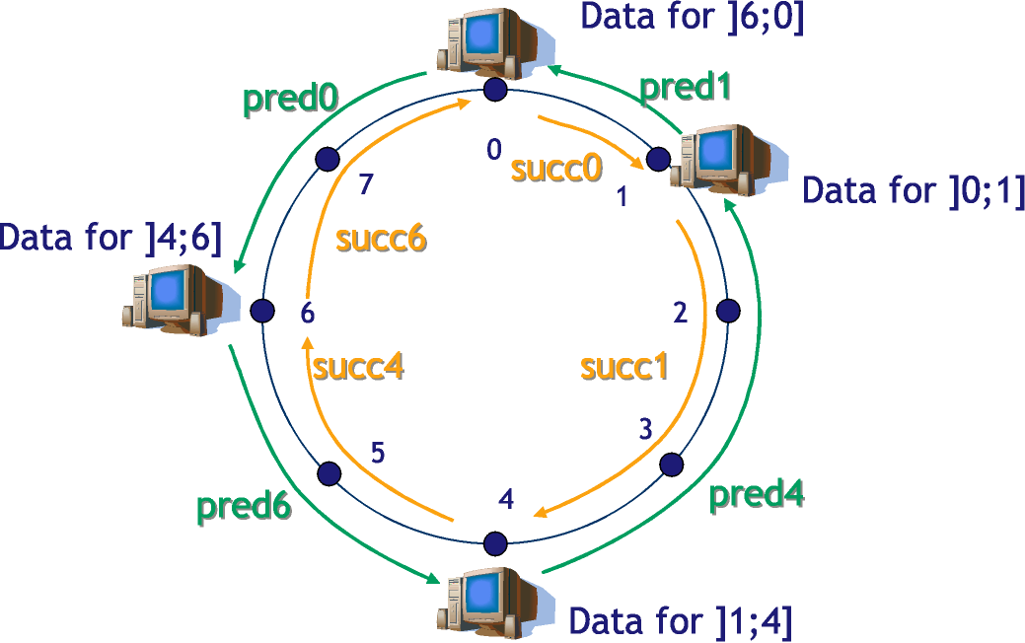
Joining: All Is Done

Slide 58
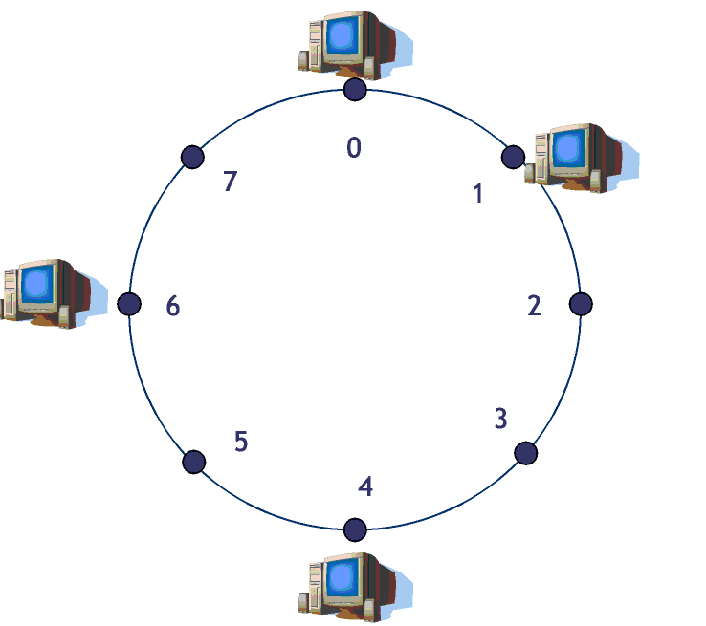
Storing a value:
Node 6 wants to store object with name “Foo” and value 5
hash(Foo) = 2

Slide 59
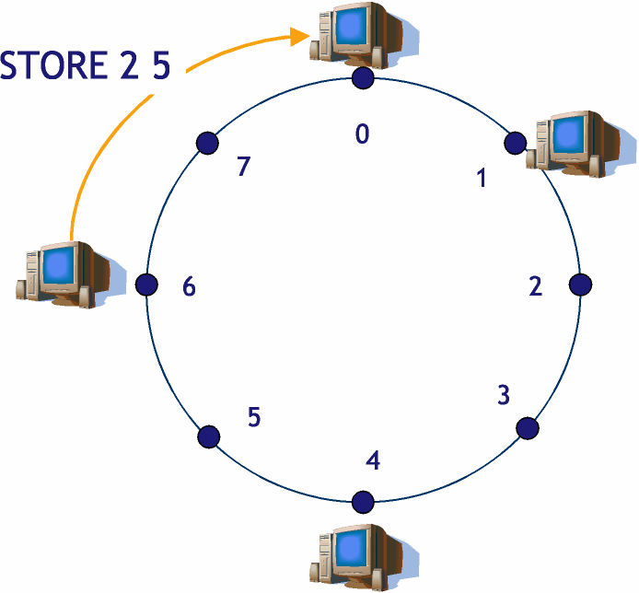
Storing a value: (Contd.)

Slide 60
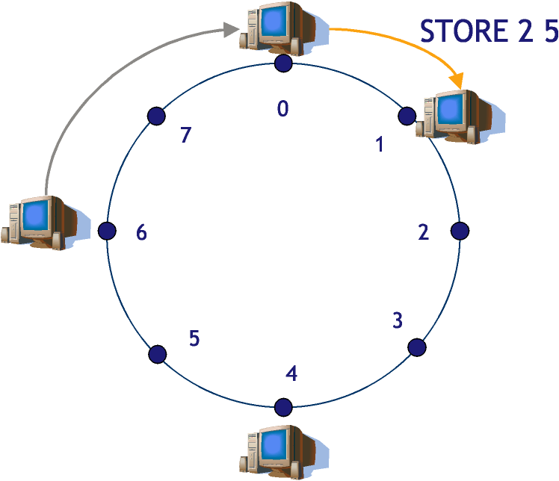
Storing a value: (Contd.)

Slide 61
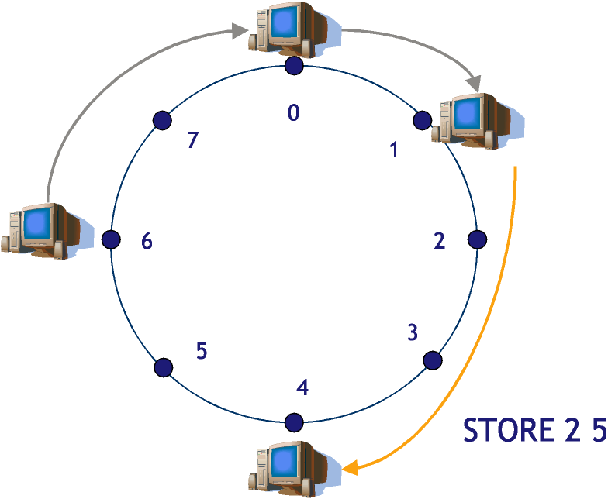
Storing a value: (Contd.)

Slide 62
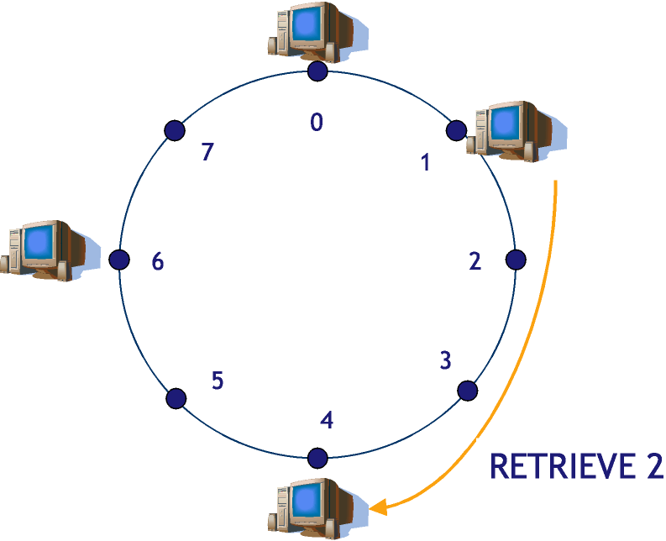
Retrieving the value
Node 1 wants to get object
with name “Foo”
hash(Foo) = 2
Foo is stored on node 4

Slide 63
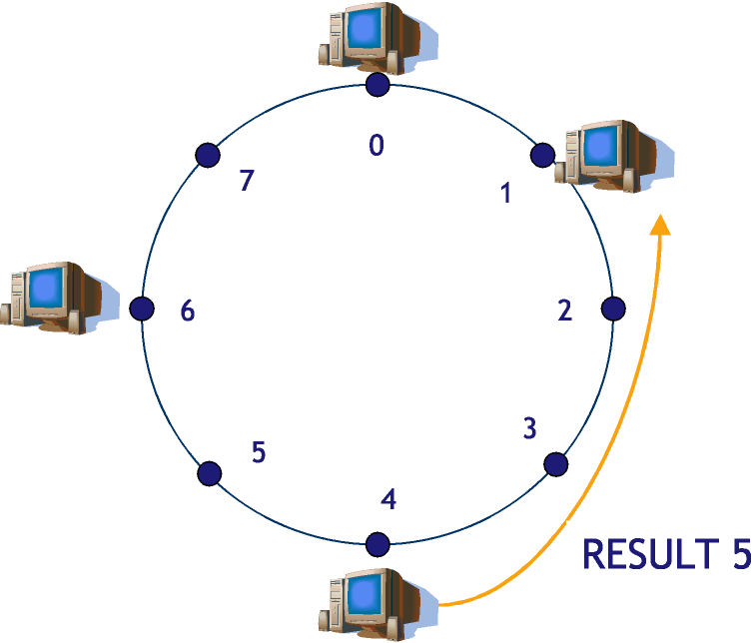
Retrieving the value (Contd.)

Slide 64
Chord: Scalable Routing
Routing happens by passing message to successor
What happens when there are 1 million nodes?
-- On average, need to route 1/2-way across the ring
-- In other words, 0.5 million hops! Complexity O(n)
How to make routing scalable?
-- Answer: Finger tables
Basic Chord keeps track of predecessor and successor
Finger tables keep track of more nodes
-- Allow for faster routing by jumping long way across the ring
-- Routing scales well, but need more state information
Finger tables not needed for correctness, only for performance improvement

Slide 65
Chord: Finger Tables
In m-bit identifier space, node has up to m fingers
Fingers are stored in the finger table
Row i in finger table at node n contains first node s that succeeds n by at least 2^{i-1} on the ring
In other words:
-- finger[i] = successor(n + 2^{i-1})
First finger is the successor
Distance to finger[i] is at least 2^{i-1}

Slide 66
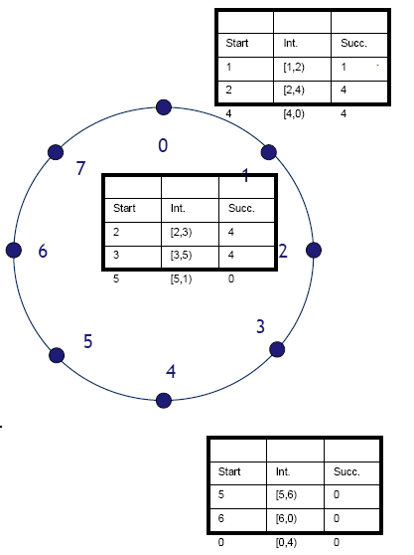
Chord: Scalable Routing
Finger intervals increase with distance
from node n
--If close, short hops and if far, long hops
Two key properties:
Each node only stores information about a
small number of nodes
Cannot in general determine the successor
of an arbitrary ID
--Example has three nodes at 0, 1, and 4
--3-bit ID space --> 3 rows of fingers

Slide 67
Chord: Performance
Search performance of “pure” Chord is O(n)
--Number of nodes is n
With finger tables, need O(log n) hops to find the correct node
--Fingers separated by at least 2i-1
--With high probability, distance to target halves at each step
--In beginning, distance is at most 2m
--Hence, we need at most m hops
For state information, “pure” Chord has only successor and
predecessor, O(1) state
For finger tables, need m entries
--Actually, only O(log n) are distinct
--Proof is in the paper

Slide 68
Readings:
Freenet
CAN
Patry

Slide 69
Queries?

